Slide 1
STORYTELLING WITH DATA
Instructor: Mallikarjun PM

Slide 2

About the instructor
Day Job: Data Scientist, IAG Firemark Labs
Loves to solve problems and build solutions using tech, has a data-first oriented mindset.
A hobbyist photographer and travel enthusiast.

Slide 3

What’s in this session ?
Need for Business Intelligence
What exactly is storytelling with data
The 3 D roles - Data Analyst, Data Engineer, Data Scientist
Basic terminologies
Practical hands-on

Slide 4


Need for Business Intelligence
A method of making informed decisions using data
Can be applied across all industries and at any scale

Slide 5
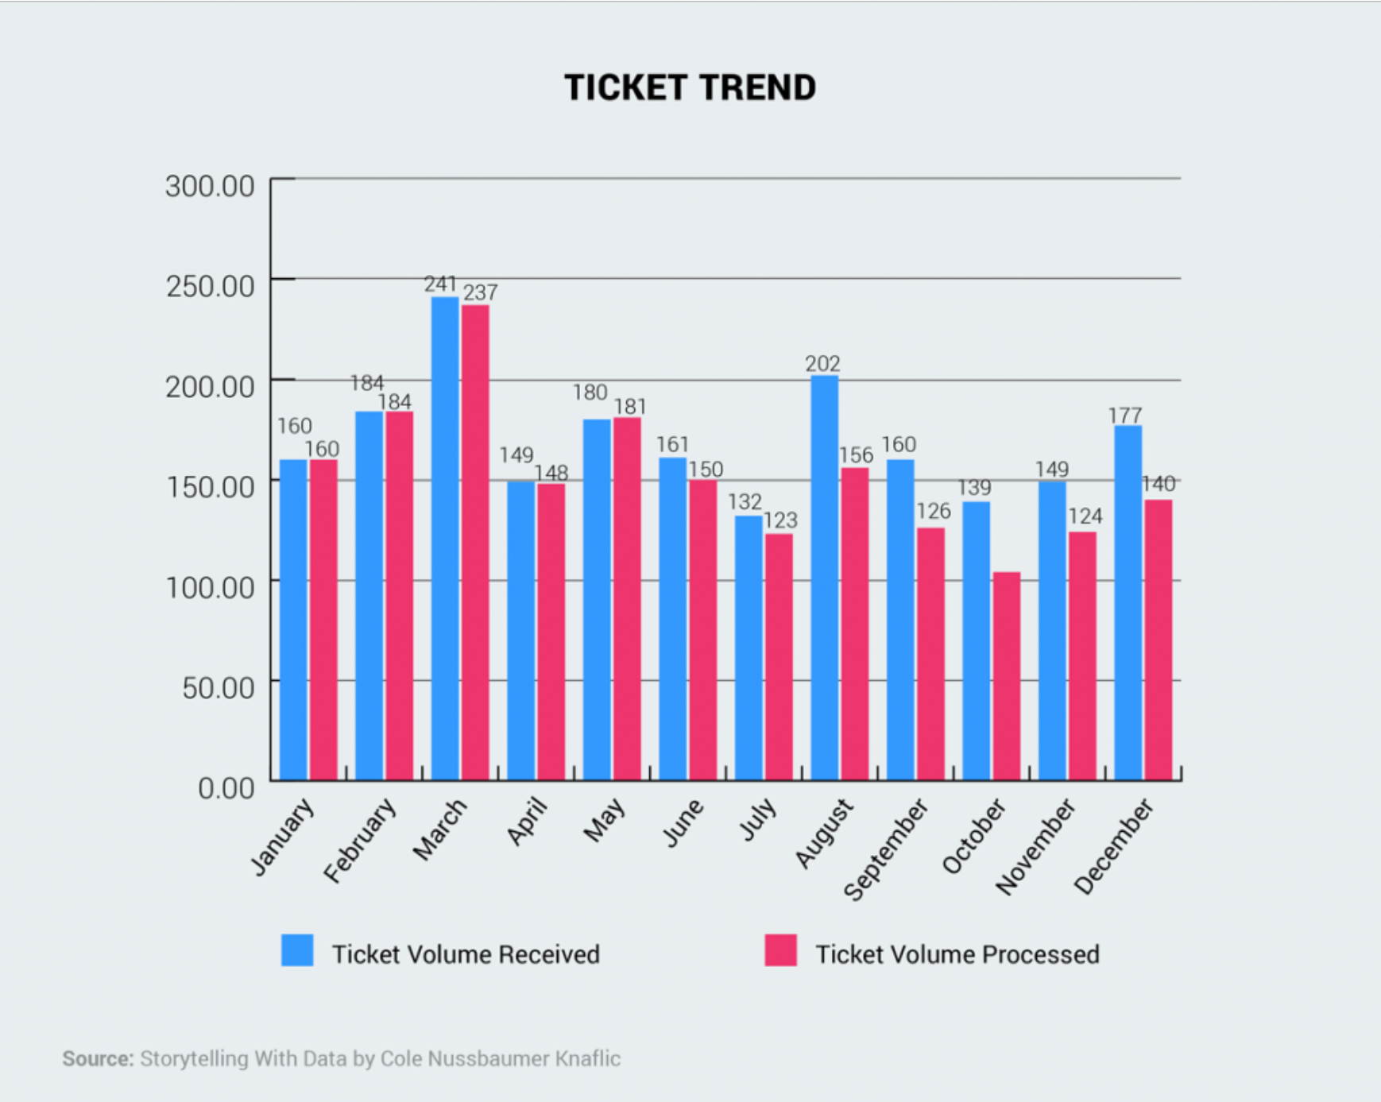
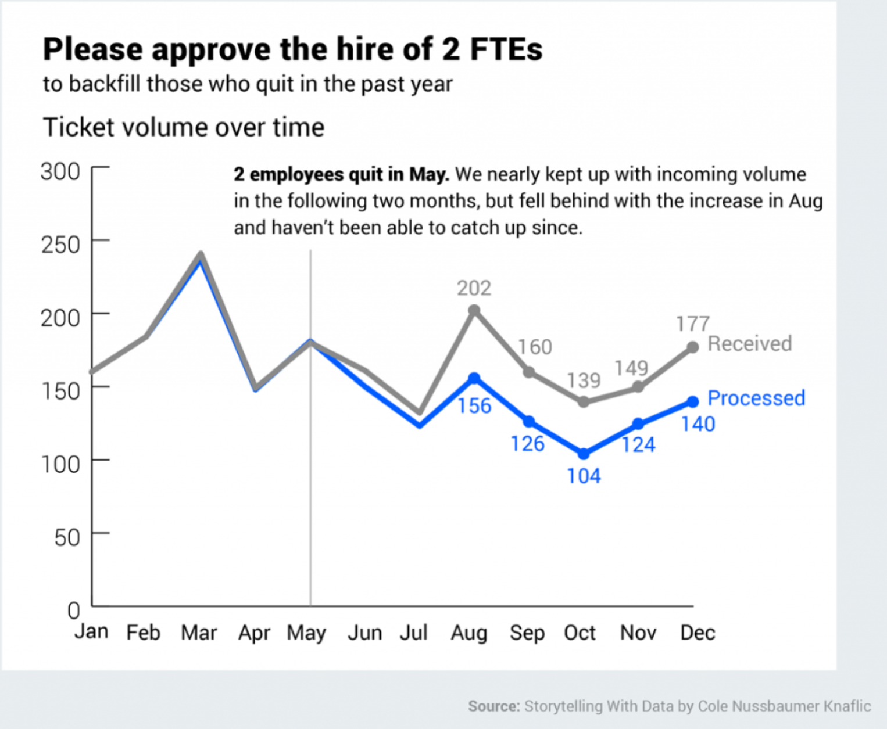
What is storytelling with data?
Communicating your findings from data using the right metrics, KPIs and intuitive visualizations
The visualization should and must convey a specific and clear message
Notes:
TASK: Identify the right vs wrong way of presenting data
Any students of business process management have a different idea?

Slide 6
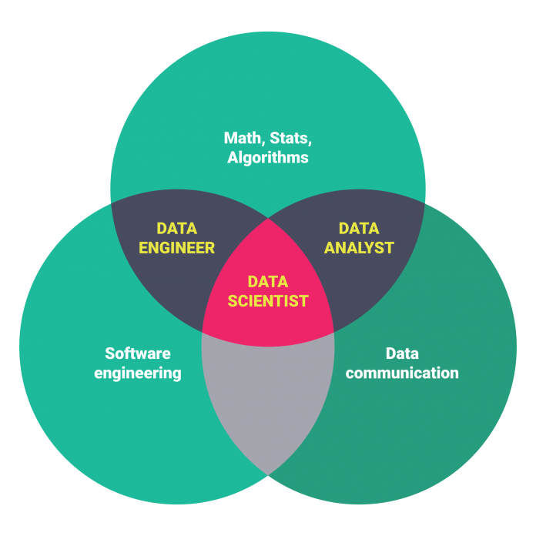
The 3D roles
Data Engineer - Infrastructure | Big Data | Pre Processing | Programming Expert
Data Analyst - Business Insights | Domain Expert | Descriptive Analytics
Data Scientist - Machine Learning | Predictive Analytics | Forecasting
Overlap between roles: 60-20-20
NOTE: All takeaways from personal experience.
Source : https://medium.com/all-technology-feeds/close-look-at-data-scientist-vs-data-engineer-56a8b09460a2

Slide 7
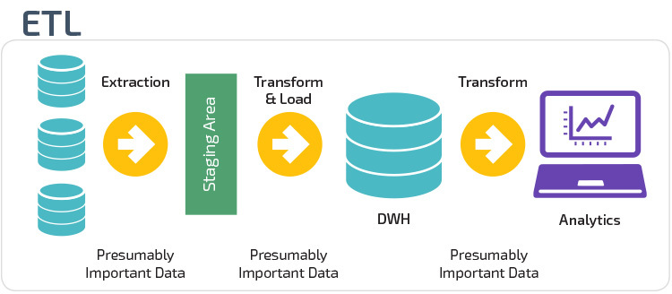
Basic Terminologies I - ETL

Slide 8
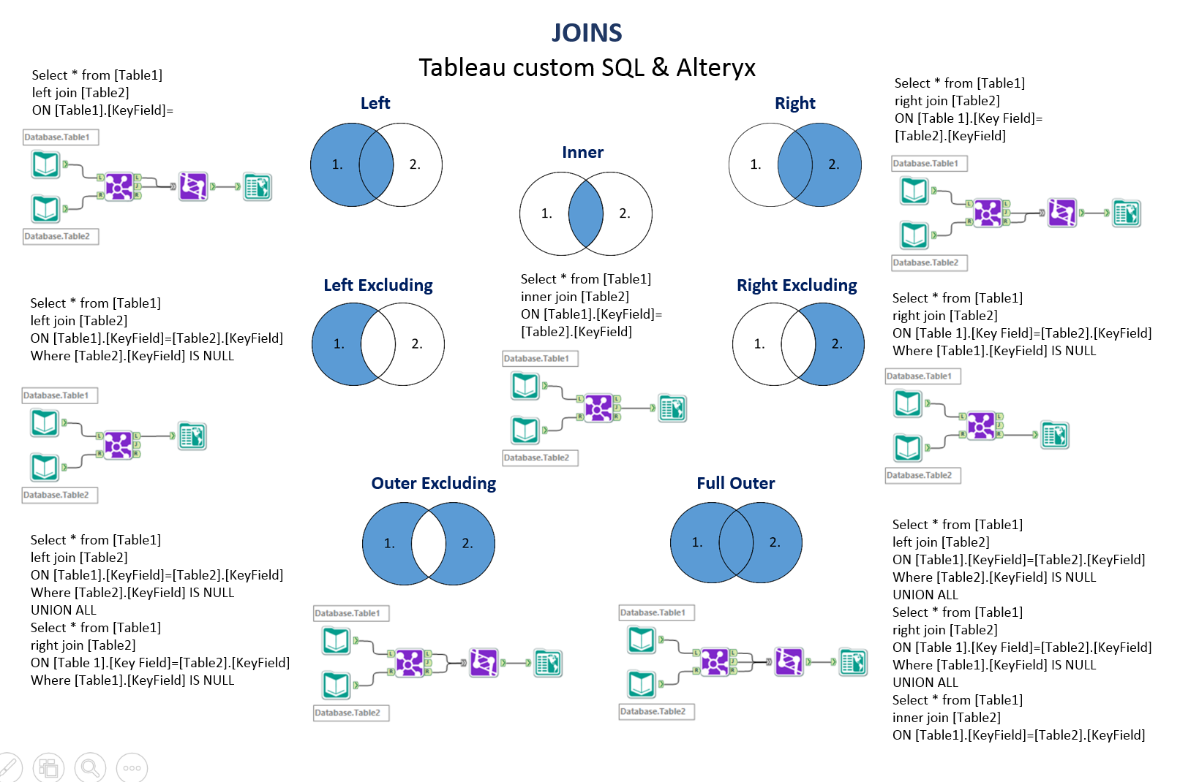
Basic Terminologies II - Joins

Slide 9
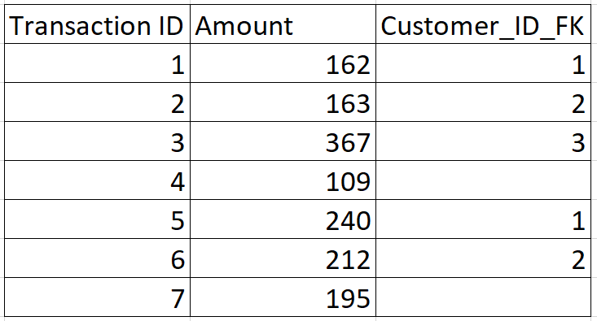
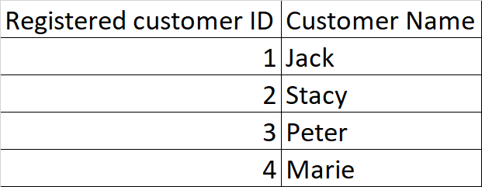
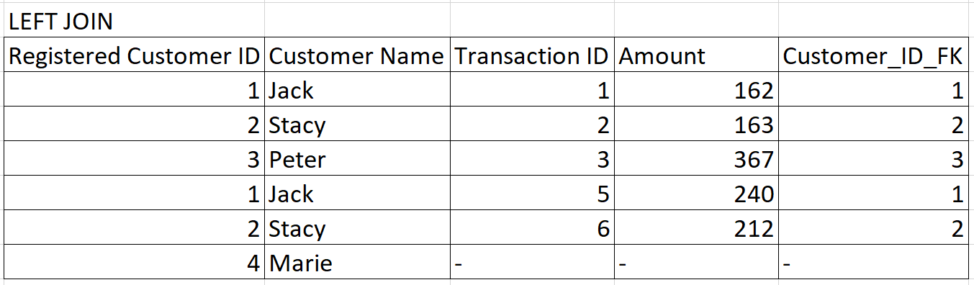

Slide 10
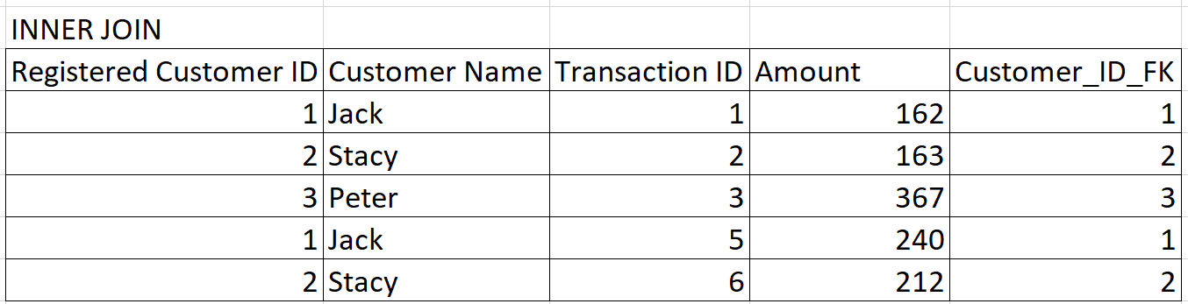

Slide 11
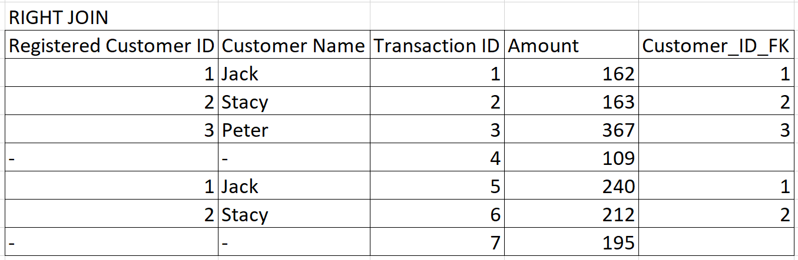

Slide 12
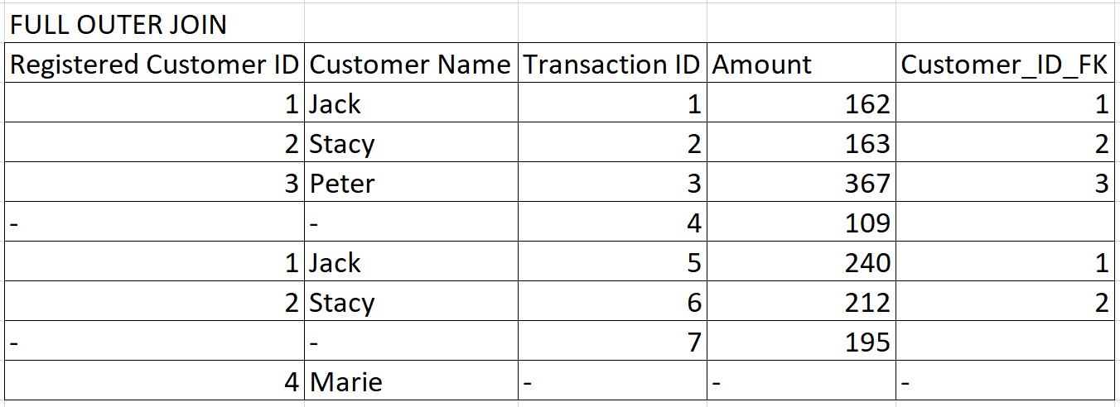

Slide 13
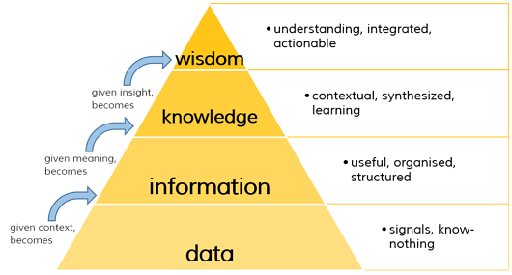
Basic Terminologies III
Dimension vs Measure
Discrete vs Continuous variables
Metric vs KPI - Profit vs % Profit per store
The DIKW pyramid
Notes:
Dimension - City name , Measure - city area
Discrete - number of siblings, continuous - hieght

Slide 14
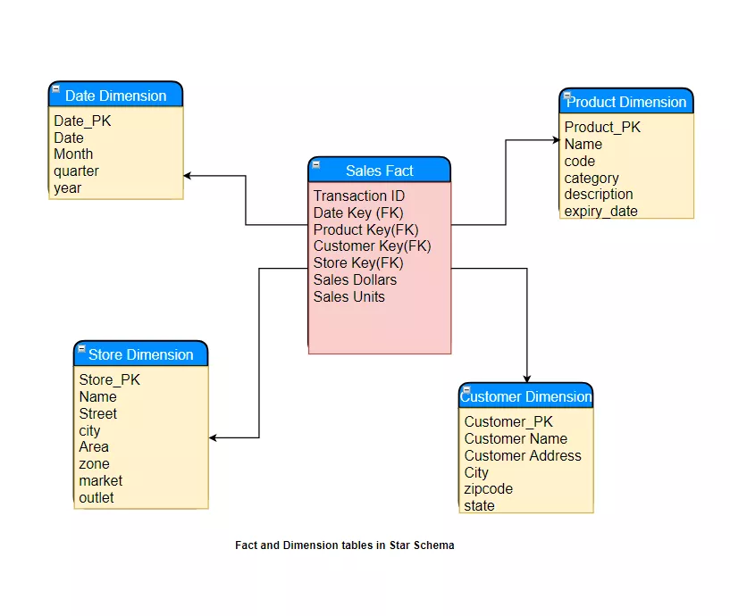
Basic Terminologies IV - Data Warehouse
Data Warehouse Star Schema

Slide 15
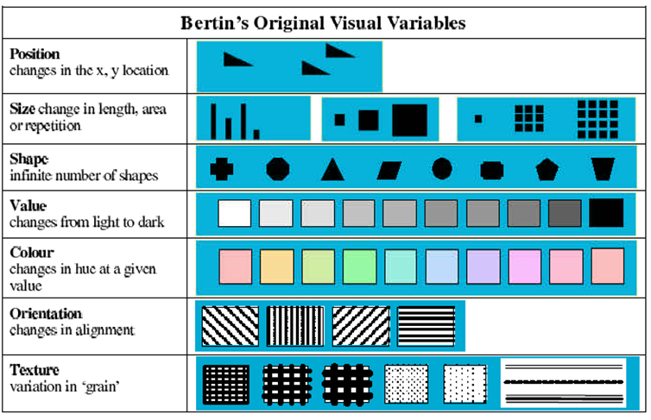
Bertin’s 7 Visual Variables
Notes:
orientation - wind direction
texture - forest vs urban

Slide 16
Charts and where to use them
Notes:
https://interworks.com/blog/ccapitula/2014/08/04/tableau-essentials-chart-types-introduction/

Slide 17
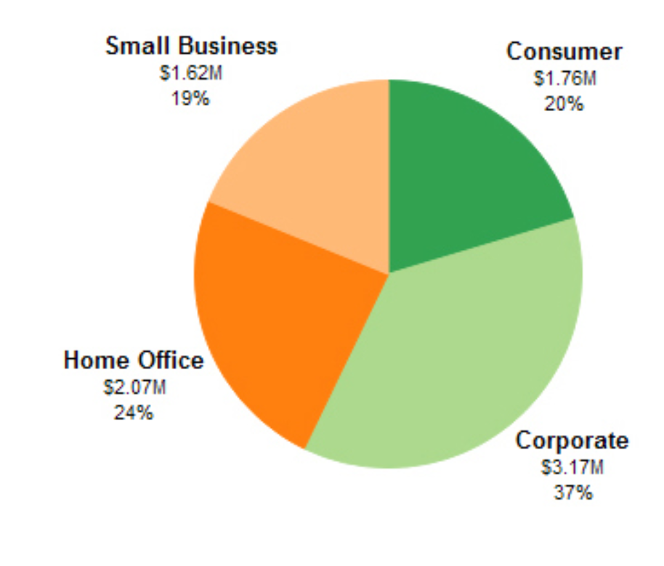
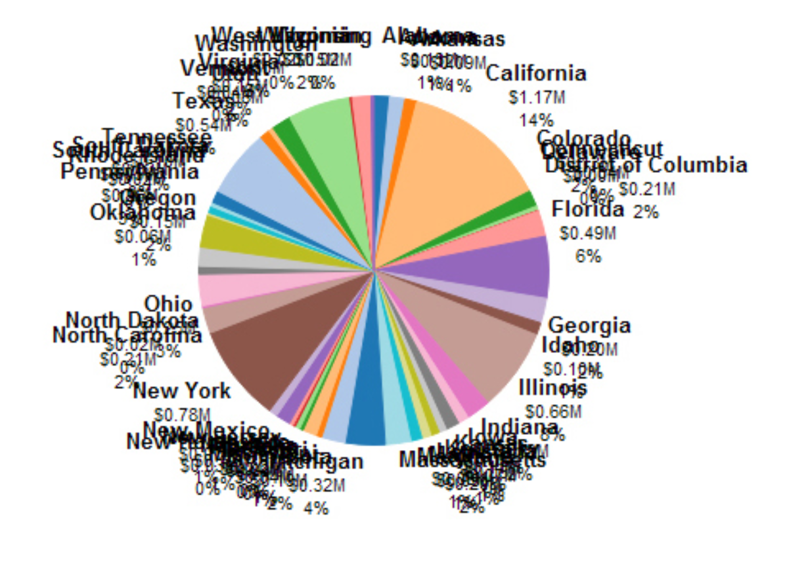
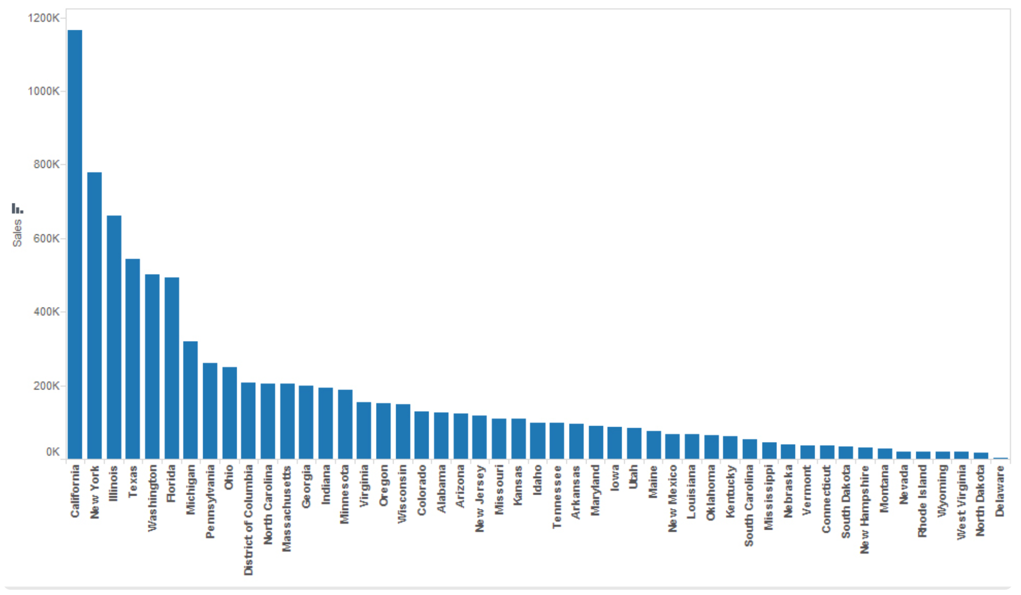
Pie Charts
Best suited to show proportional or percentage relationships.
When used appropriately, pie charts can quickly show relative value to the other data points in the measure.
Tableau recommends that users limit pie wedges to six

Slide 18
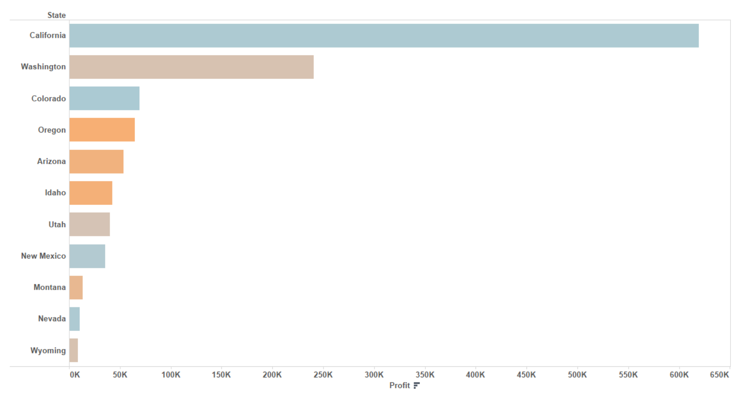
Horizontal Bar Charts
It makes data really digestible and tells a good story.
We can easily see which categories have higher numbers compared to other categories.
Minimum Requirements: 0 or more dimensions, 1 or more measures

Slide 19
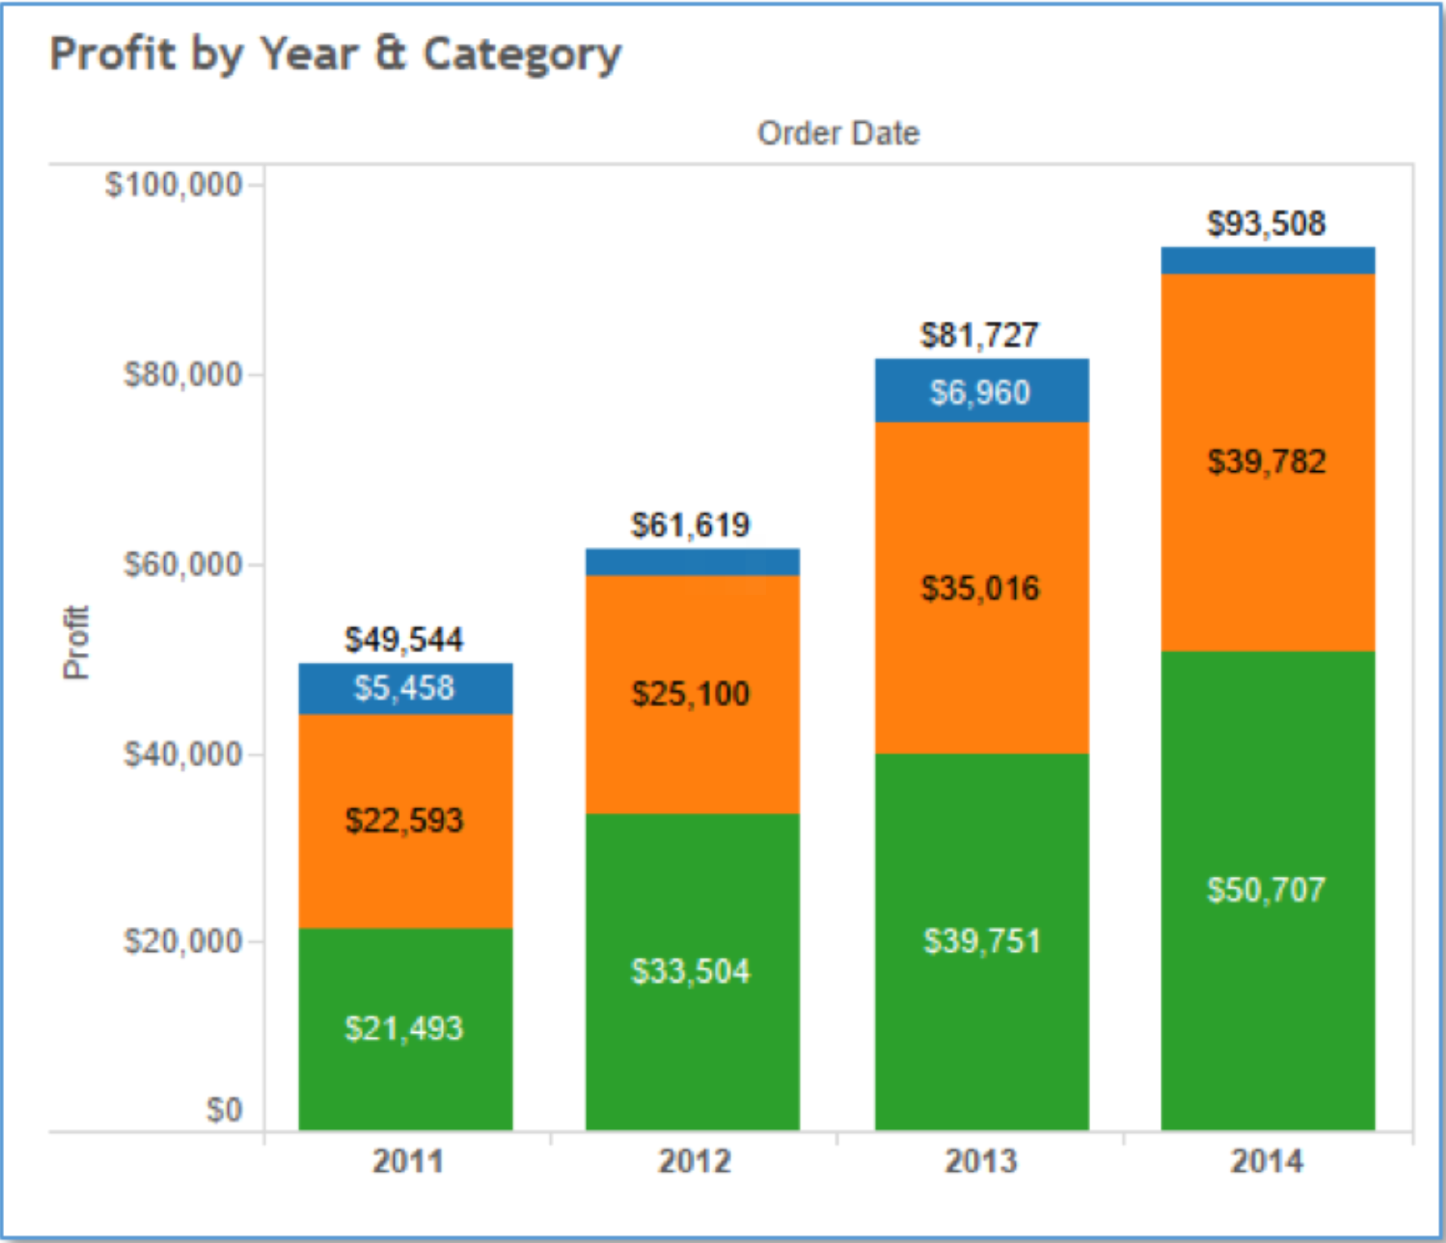
Stacked Bar Chart
You can use the stacked bar chart to show data in categories that are also stratified into sub-categories.
It allows us to see more details than the regular bar chart would provide.
Minimum Requirements: 1 or more dimensions, 1 or more measures

Slide 20
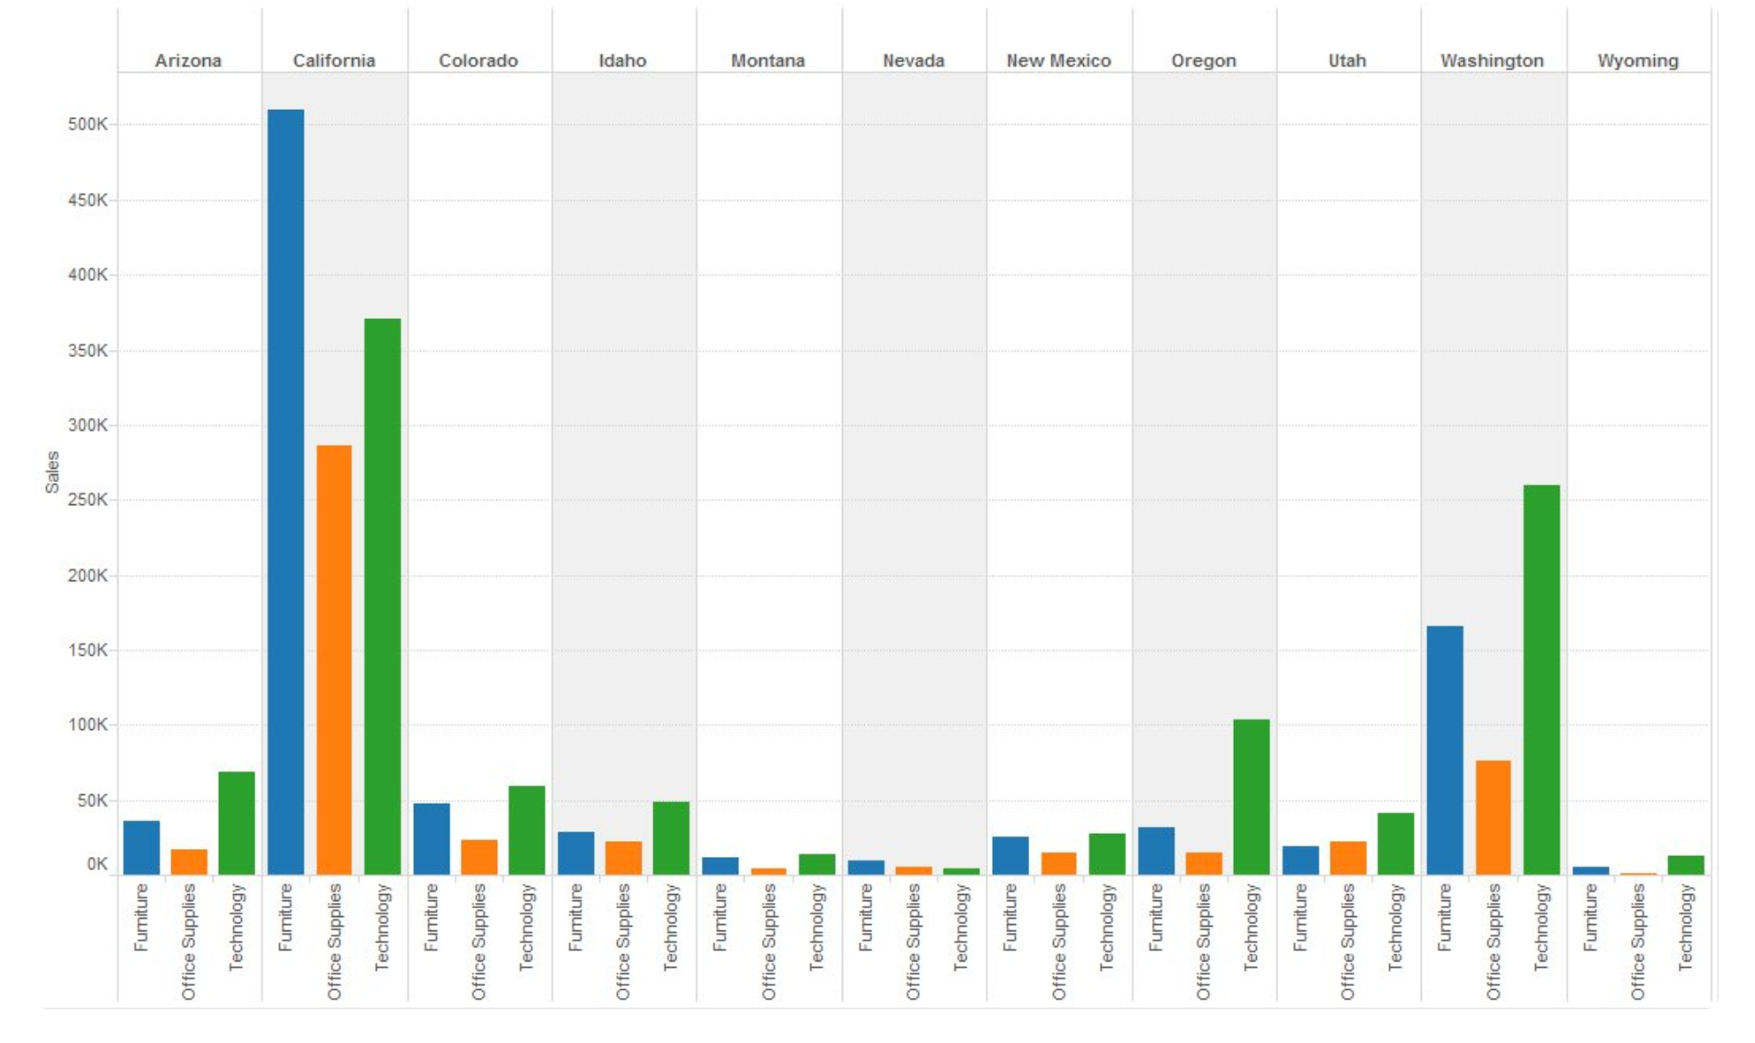
Side by Side Bar Chart
Show a side by side comparison of data.
The side-by-side bar chart is similar to the stacked bar chart except that it is un-stacked the bars and put the bars side by side along the horizontal axis.
Minimum Requirements: 1 or more dimensions, 1 or more measures

Slide 21
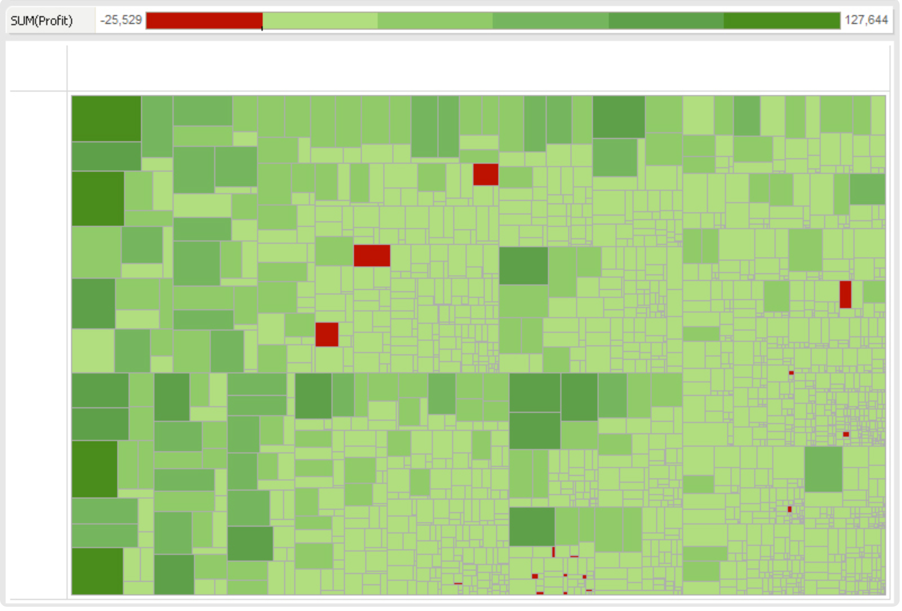
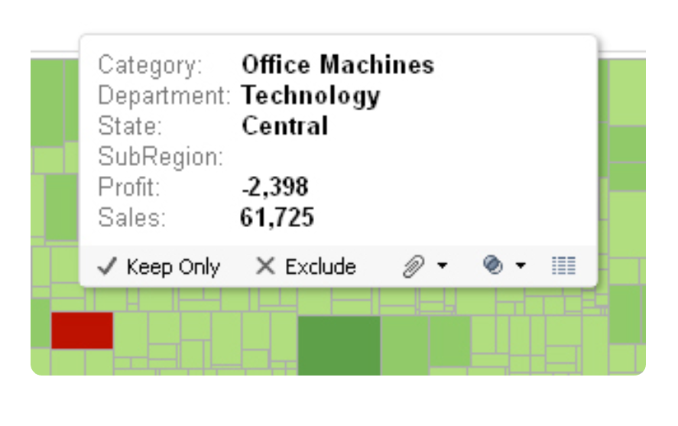
Treemap
Use a treemap to show hierarchical (tree-structured) data and part-to-whole relationships.
Treemapping is ideal for showing large amounts of items in a single visualization simultaneously.
Minimum Requirements: 1 or more dimensions, 1 or 2 measures

Slide 22
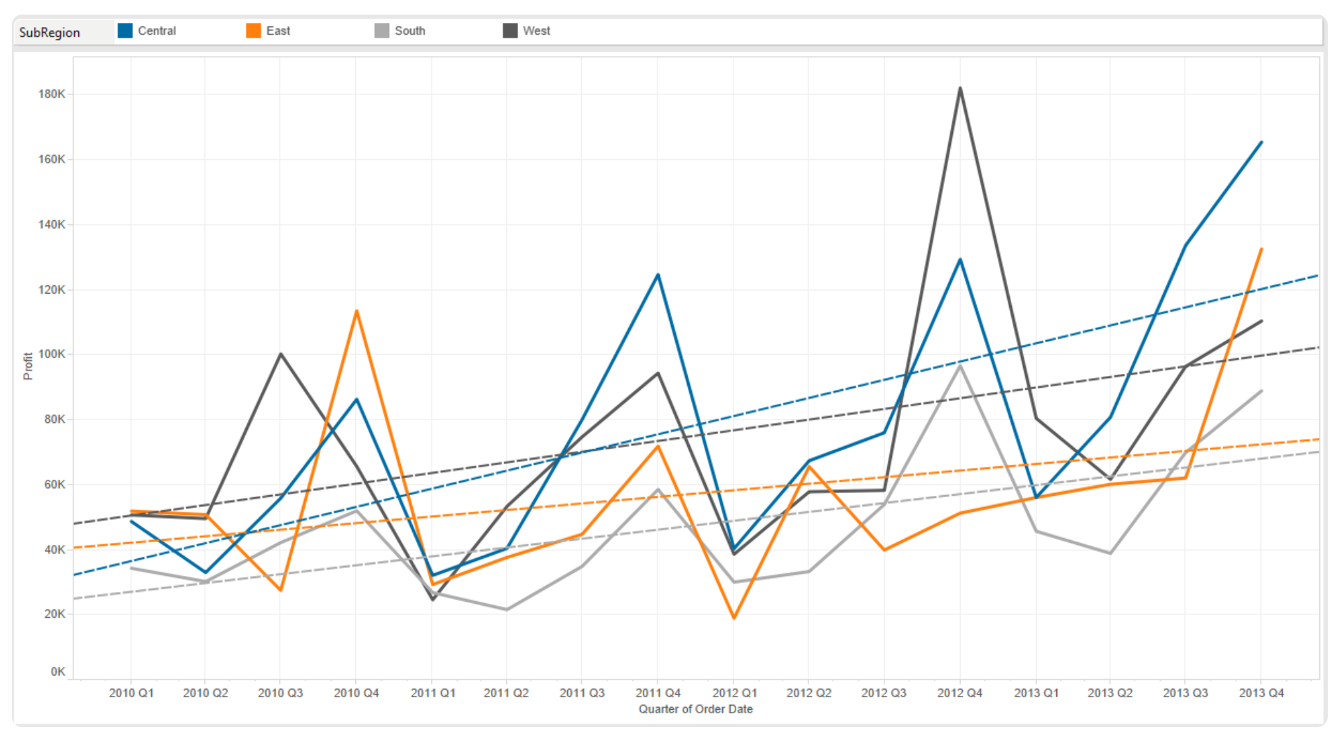
Line Chart (Continuous)
This is extremely helpful when you are trying to tell a story of how things changed over a period of time.
You can use several number of lines in the view to show continuous flow of data.
Minimum Requirements: 1 date, 0 or more dimensions, 1 or more measures

Slide 23
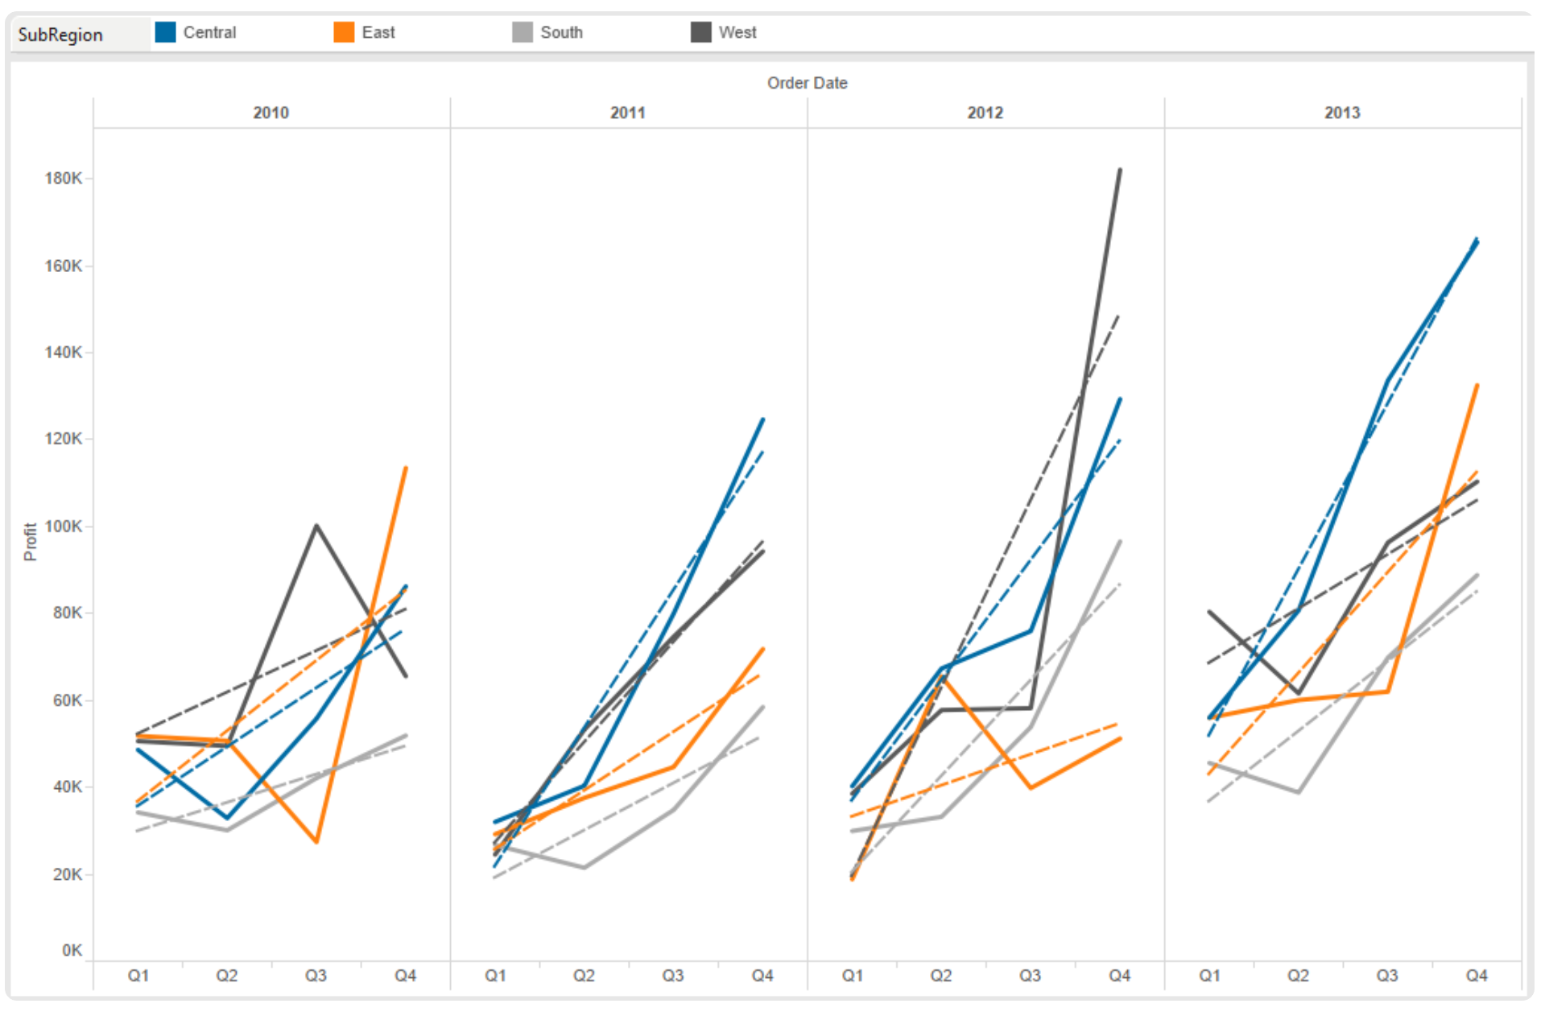
Line Chart (Discrete)
Must have a date field in order to use this graph.
The difference between the two is the type of data you are showing, discrete vs. continuous.
Slice and dice the graph for deeper analysis.
Minimum Requirements: 1 date, 0 or more dimensions, 1 or more measures

Slide 24
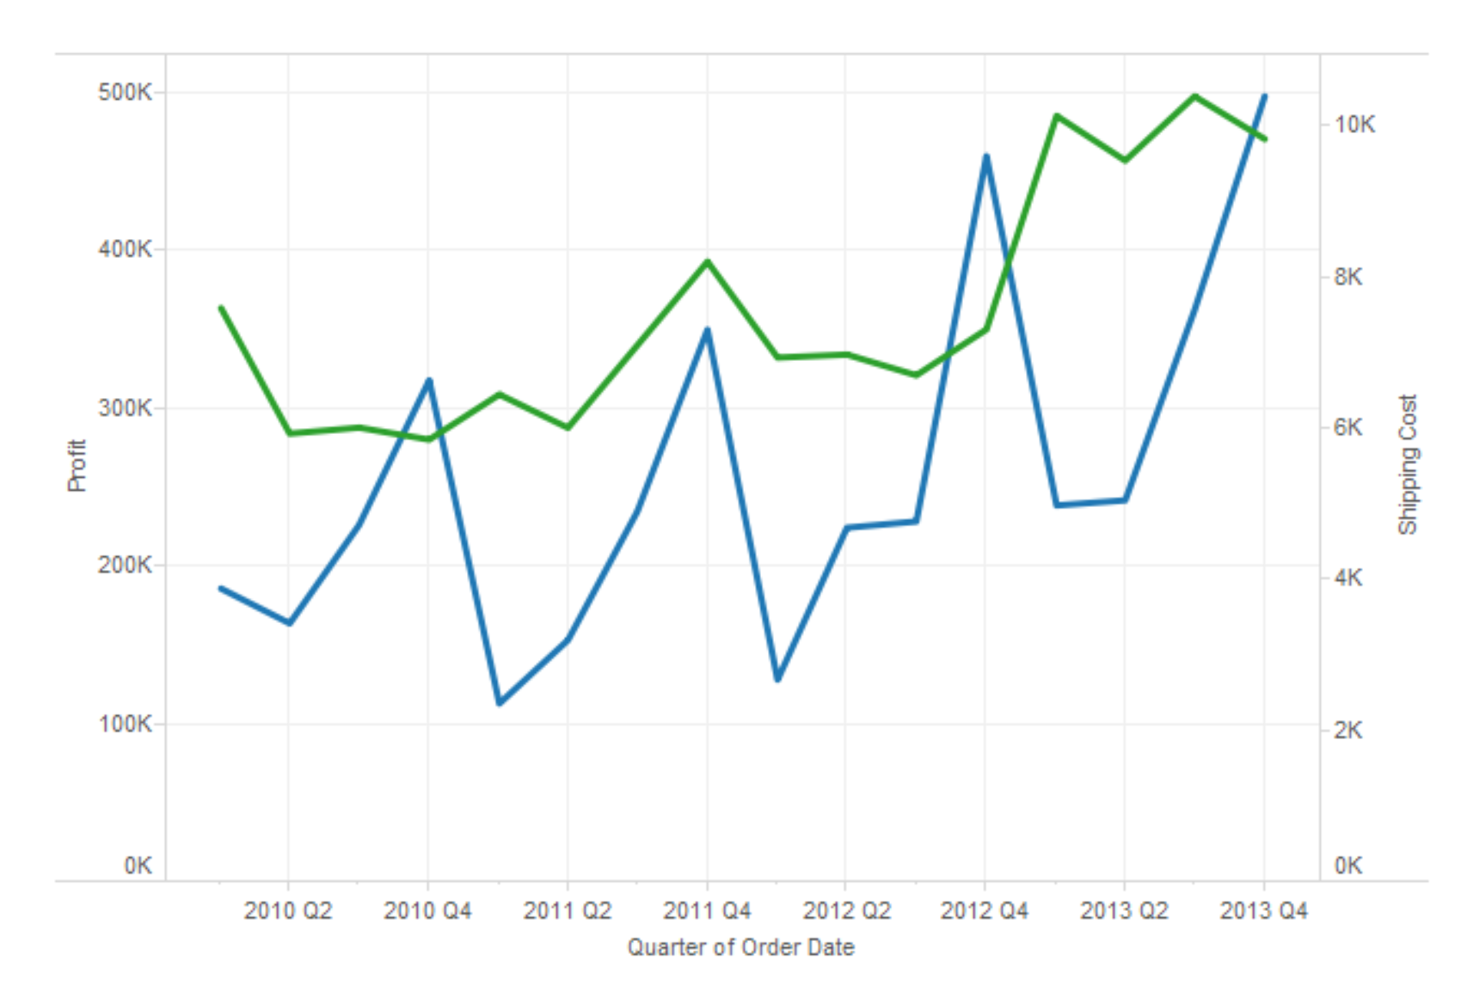
Dual Line Chart
Use when comparing two measures over a period of time
This view produces unsynchronized axis . It allows for more than one measure to be represented with two different axis ranges.
Minimum Requirements: 1 date, 0 or more dimensions, 2 measures

Slide 25
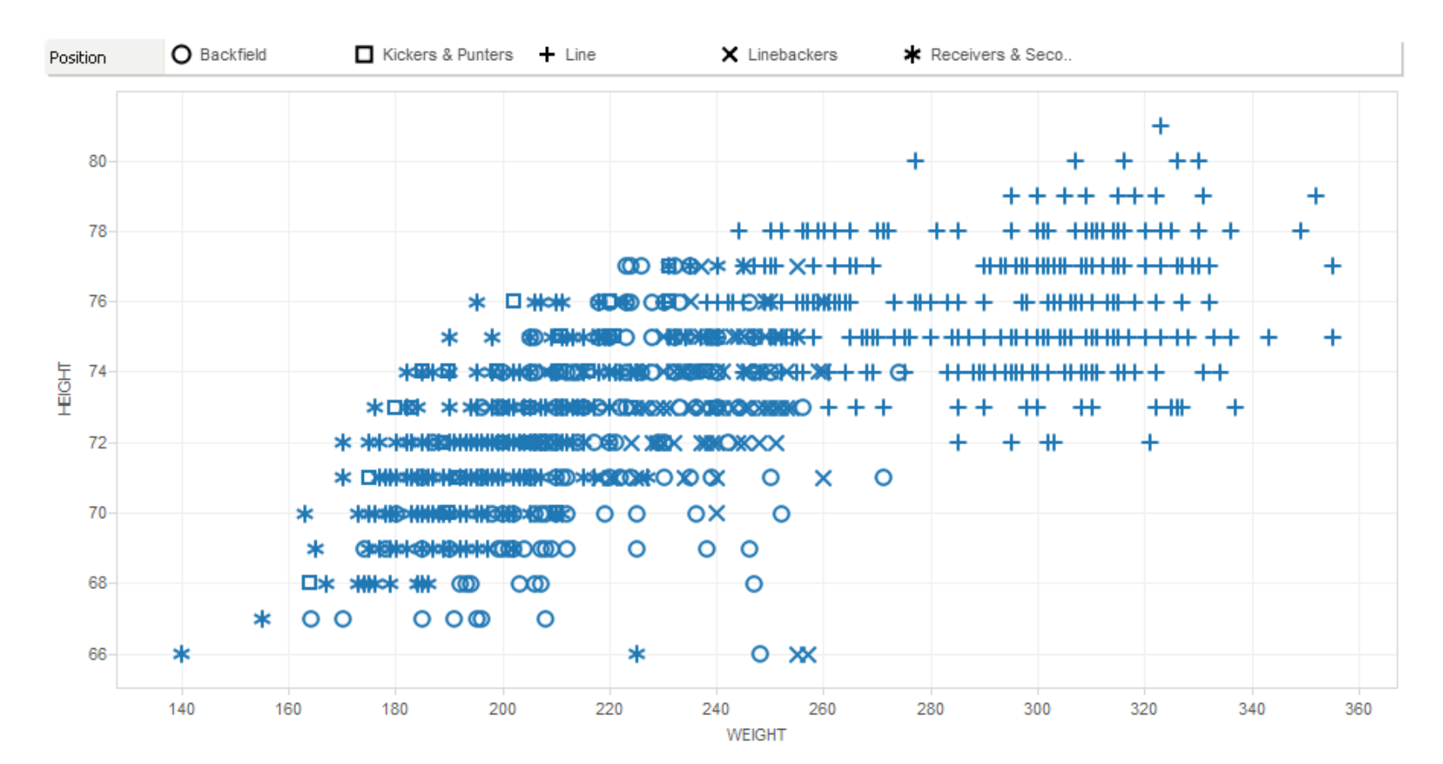
Scatterplots
Are great for comparing two different measures and identifying patterns.
The scatter plot also uses symbols to visualize data.
In a scatter plot, both axes in the chart are measures rather than dimensions.
You can add a trend line into scatter plots; this will clearly define the correlation among your data
Minimum Requirements: 0 or more dimensions, 2–4 measures

Slide 26
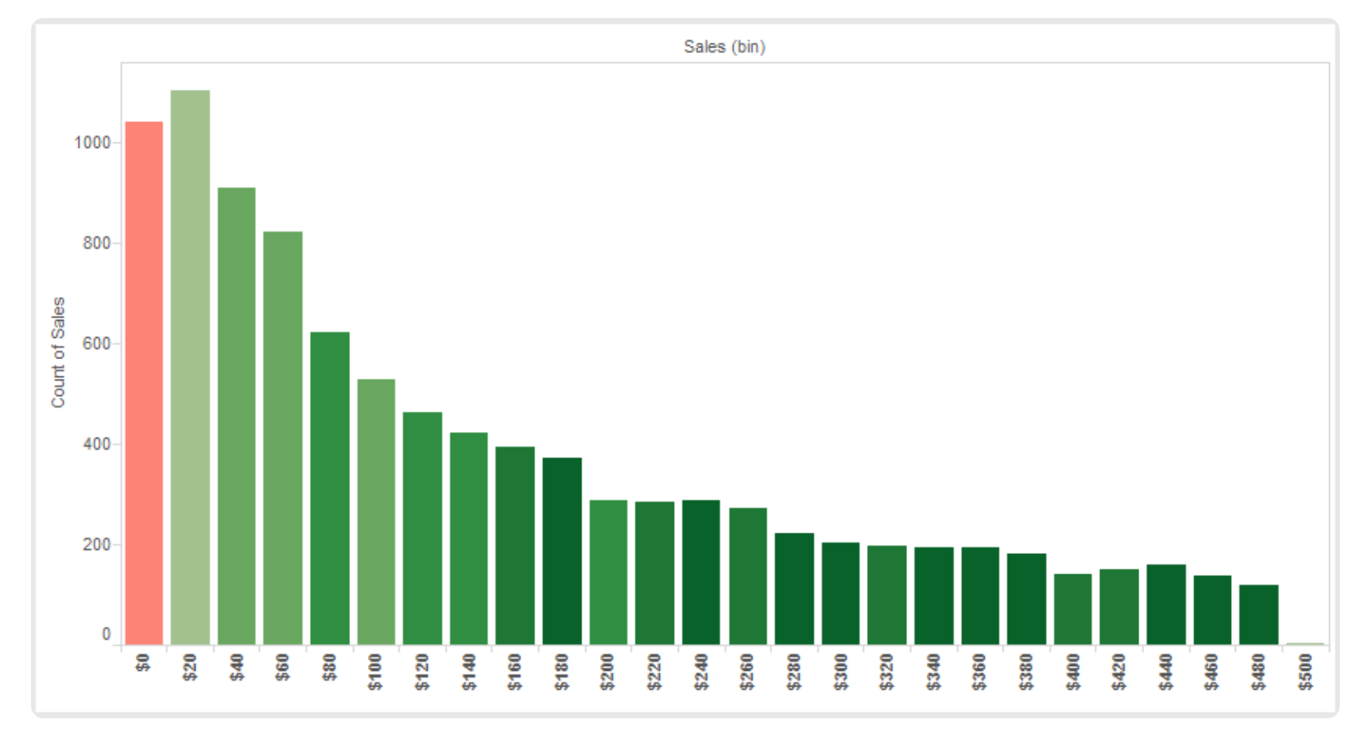
Histogram
A histogram is a visual representation of the distribution of data.
This is very useful when you want to analyze how the data is distributed.
Minimum Requirements: 1 measure (bin field)

Slide 27

Storytelling in action

Slide 28

Practical Hands-On
Dataset : retail purchase
Visualization Tool : Tableau Public
Choose your metrics and KPIs wisely !
https://public.tableau.com/profile/arjun.pmm#!/

Slide 29
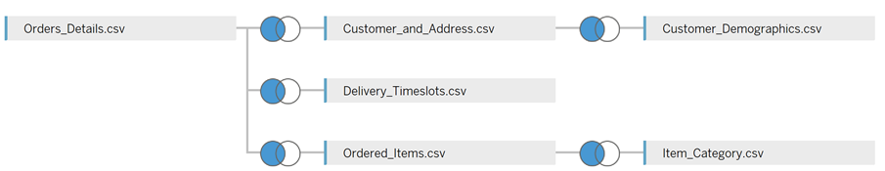

Slide 30
Resources
https://www.dummies.com/programming/big-data/big-data-visualization/tableau-for-dummies-cheat-sheet/
https://interworks.com/blog/ccapitula/2014/08/04/tableau-essentials-chart-types-introduction/

Slide 31
Thank You
Questions?

